Slide 1
CAP7001:
Data Communication and Networking
Unit-II
Networking Devices

Slide 2
Networking Devices
Organize and structure the network.
Enable network connectivity for devices.
Route packets within and between networks.
Strengthen and boost signal strength.
Allow communication and file sharing.

Slide 3
Types of network devices
NIC
Modem
Hub
Repeater
Bridge
Switch
Router
Gateway

Slide 4
Network Interface Card (NIC)
NIC is a network interface card.
Allows devices to join networks.
Operates at OSI physical/data link.
Has unique MAC address in ROM.
Supports wired and wireless links.

Slide 5
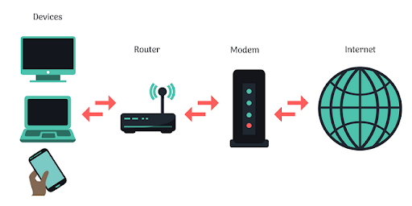
Modem
Converts digital to analog signals.
Also converts analog to digital.
Enables computer use of phone lines.
Modulation: digital to analog conversion.
Demodulation: analog to digital conversion.
Modem speed measured in bps.

Slide 6
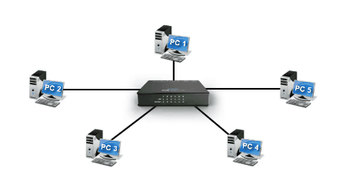
Hub
Connects LAN segments with ports.
Broadcasts incoming data to all.
Types: passive, active, intelligent.
Passive: no amplifier, no power.
Active: amplifies signal, needs power.

Slide 7
Passive Hub
Passive hub does not amplify signals.
Does not boost or manipulate traffic.
Simply passes received signals through.
Requires no electrical power supply.
Used in simple, small networks.

Slide 8
Active Hub
Passive hub does not amplify signals.
Does not boost or manipulate traffic.
Simply passes received signals through.
Requires no electrical power supply.
Used in simple, small networks.

Slide 9
Intelligent Hub
Also called smart hub device.
Functions as an active hub.
Includes diagnostic capabilities onboard.
Contains microprocessor chip embedded.
Useful for network troubleshooting.

Slide 10
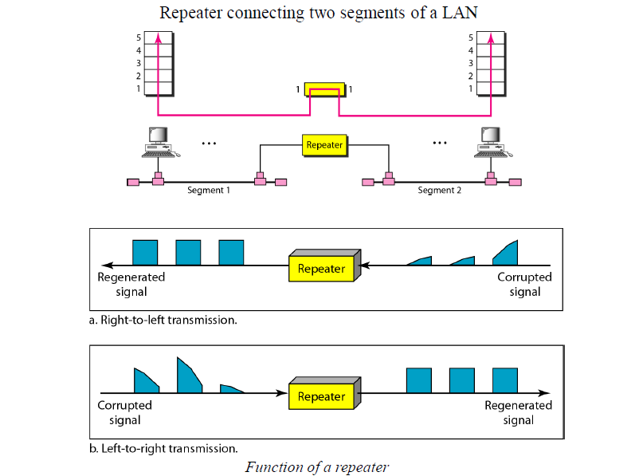
Repeaters
Repeater regenerates weak signals.
Extends transmission range in networks.
Operates at physical layer (Layer 1).
Cleans noise and distortion.
Connects network segments seamlessly.

Slide 11
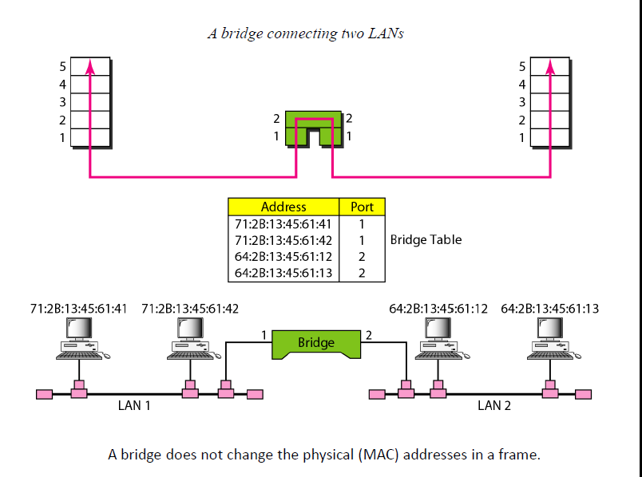
Bridges
Bridge connects two LAN segments.
Operates at data link layer.
Filters and forwards frames selectively.
Reduces network traffic and collisions.
Helps divide large networks efficiently.

Slide 12
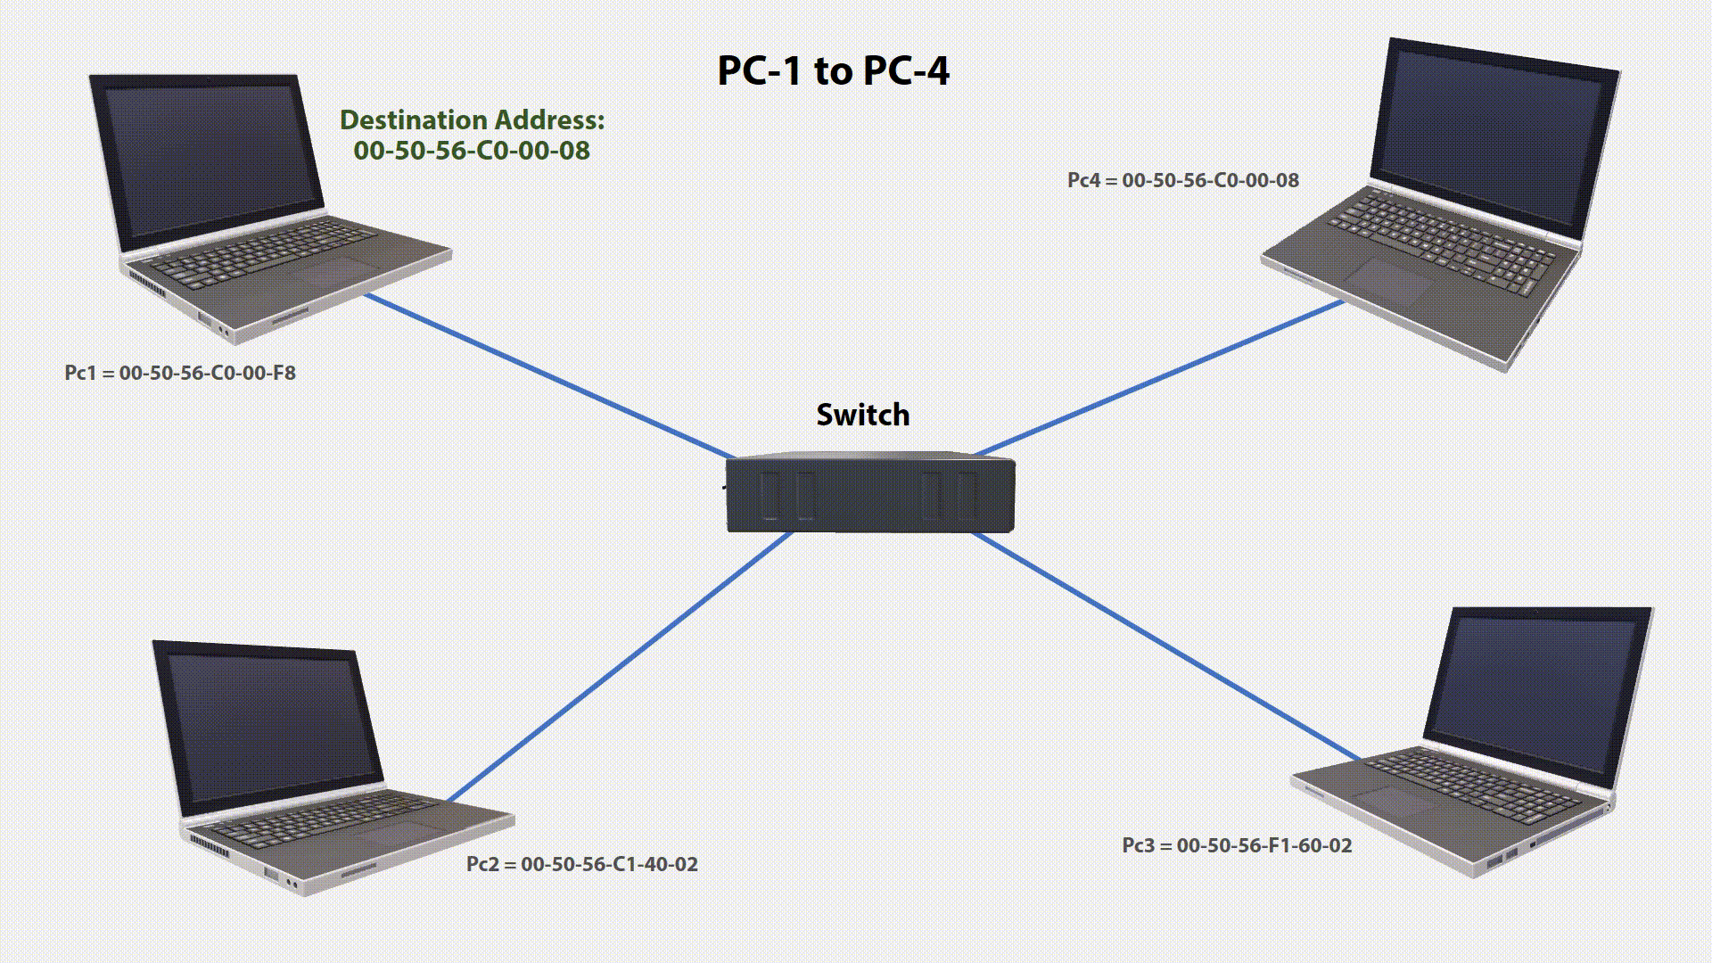
Switch
Connects devices with multiple ports.
Processes and routes data frames.
Operates at data link layer.
Uses cut-through and store-forward.
Cuts errors or delays respectively.

Slide 13
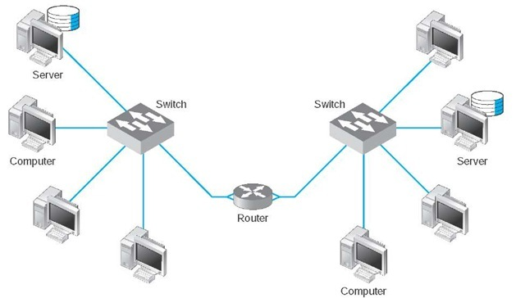
Router
Network layer device.
Connects LANs and ISPs.
Routes packets by address.
Static/dynamic routing tables.
Optimizes data paths.

Slide 14
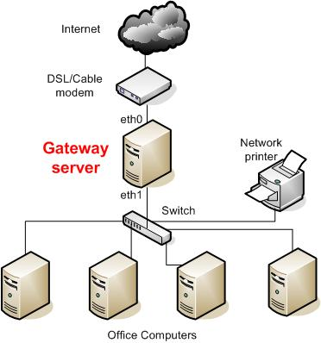
Gateway
Entry point between networks.
Translates protocols and formats.
Supports NAT and DHCP.
Regulates network traffic.
Enables inter-network communication.
NAT: Network Address Translation
DHCP: Dynamic Host Configuration Protocol

Slide 15
THANK YOU

